Slide 1
Problem Statement
The current process for managing client leads in Salesforce involves manual, one-by-one email communication without proper tracking or follow-up,
leading to a lack of lead management and potentially missed opportunities for engagement and conversion.
Solution Statement
Implementing Salesforce automation using Lightning Flow involves creating a record-triggered flow and scheduling flows to streamline processes efficiently. when we will get the lead automatic mail go client mail id and its fire continuously 6 Months at appropriate time period. In case client give the reply than it will stop automatically.
Outcome & Conclusion
Implementing Lightning Flow automation in Salesforce benefits the client by enhancing efficiency:
it automates tasks, reduces manual efforts, ensures timely follow-ups with leads,
and improves overall lead management for increased conversion opportunities.

Slide 2
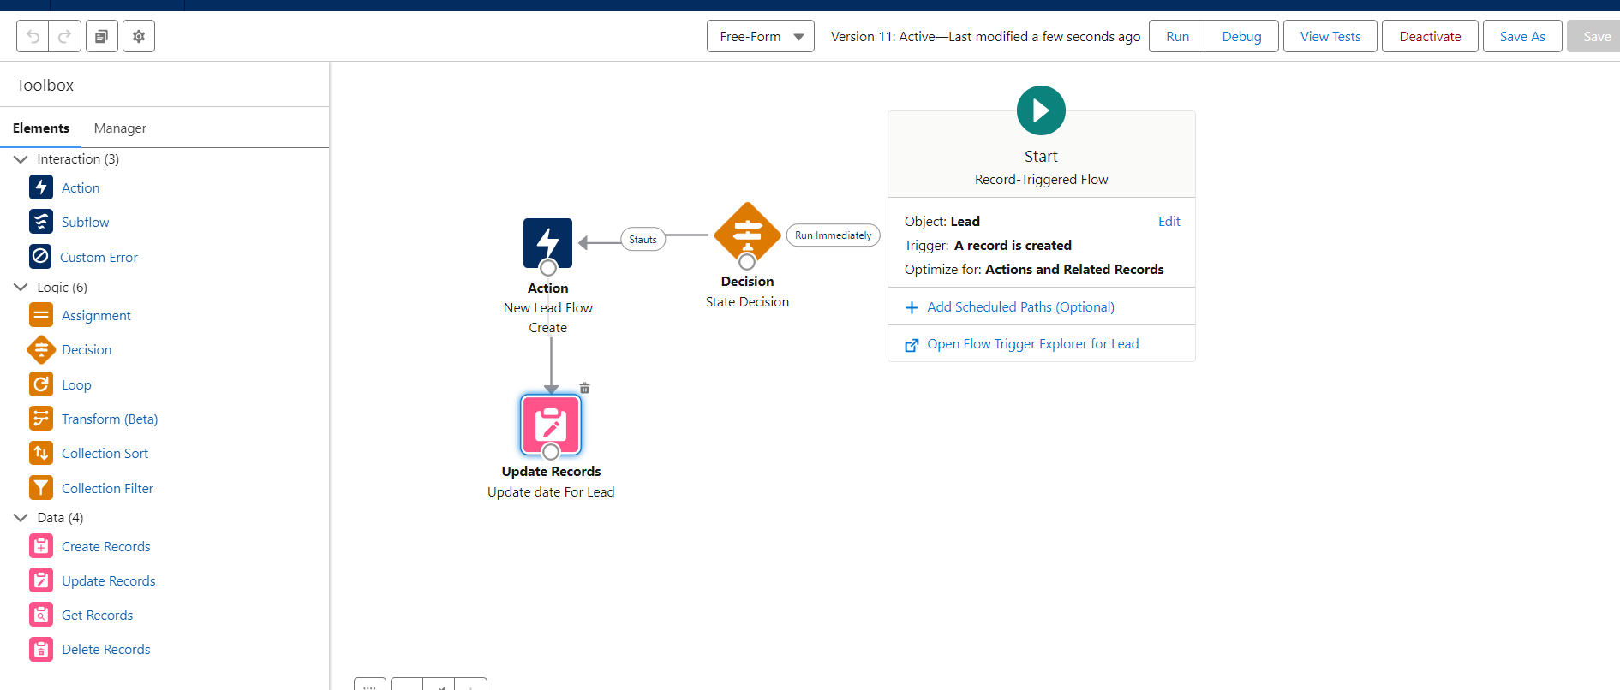
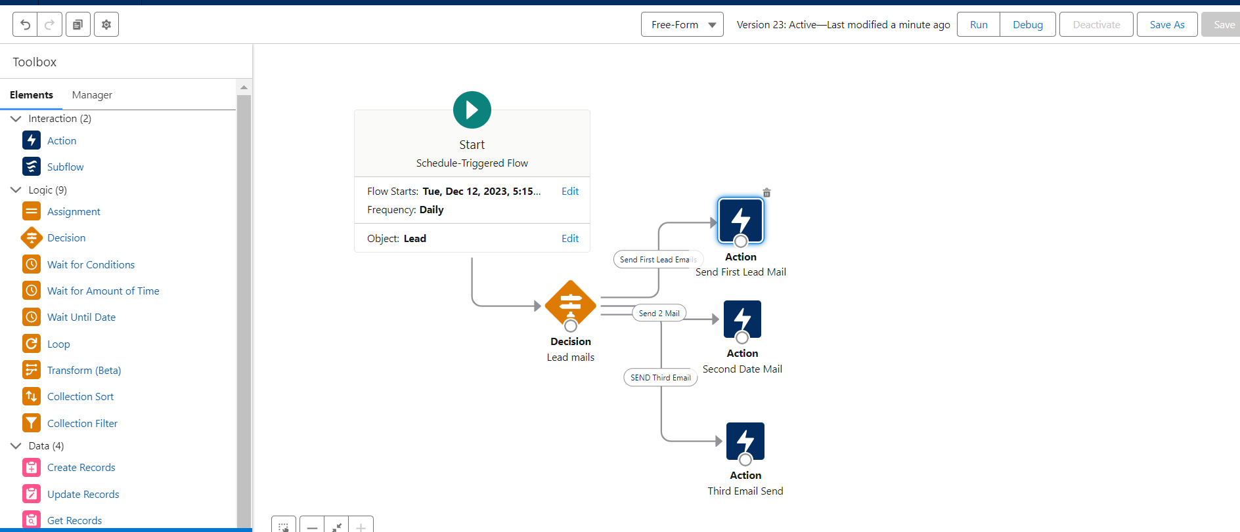
Solution Diagram

